Slide 1
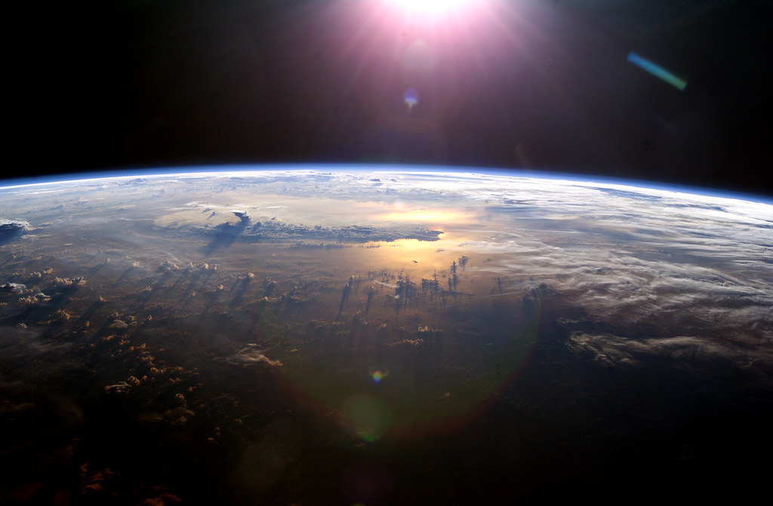




Exploration through Innovation
  Presented By: Janet Nevarez
  Mentor: Paul Scowen
  ASU School of Earth and Space Exploration
  NASA Space Grant Symposium / Tucson, AZ
  April 17th-18th , 2020

Slide 2
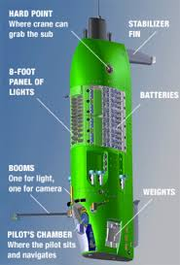
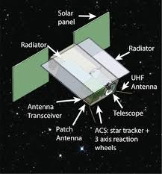
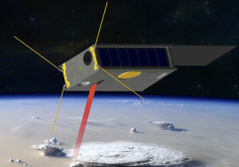


Projects
SPARCS
SWARMS
CUTLASS

Slide 3

Objectives
SPARCS
  Monitor flares and sunspot activity on M-type stars, in the far and near ultraviolet
  3 Major Systems
    Telescope
    Camera
    Operational & Science Software
SWARMS
  Self assembling group of CubeSats
  Earth observing science to map the structure and content of the Earth’s atmosphere
  Precipitable Water Vapor
  Modeling Forecasts of humidity and precipitation
CUTLASS
  Underwater platform with the intention of supporting long duration site survey missions
  Maximizing both the depth of the dive as well as the time performing the science experiments

Slide 4
Analysis
SPARCS
  I will be evaluating and conducting acceptance testing
  I will also be focusing on structure and tolerancing.
  Other testing includes
    Payload Assembly and Integration
    Optical Testing
    Thermal Testing
SWARMS
I was able to create a design that will allow us to place the compact millimeter-wave instrument on top given the 6U dimension limitations
Through CAD modeling I was able to figure out its length parameters given a specific focal point.
CUTLASS
Conducted trade study to distinguish the differences between hydraulic and electric thrusters
Currently, researching power consumption and what the power source may be
Currently creating drag profiles through fluid simulation on Solidworks

Slide 5
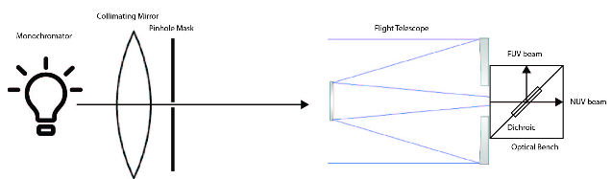
Next Steps
SPARCS
  Limited due to current events
  Optical Testing
SWARMS
  Finalize a design in conjunction with JPL, USC, GA Tech, U. Michigan
CUTLASS
  Prepare for PDR by completing the propulsion, electrical and structure subsystems
  Finalize a design the meets the current requirements

Slide 6
Acknowledgements
I would like to express my special thanks and gratitude to my mentor Paul Scowen for allowing me the amazing opportunity to join his lab and get to be a part of all these awesome projects! I have truly learned so much! I would also like to thank my colleagues John Gamaunt and Logan Jensen for guiding me along the way. Thank you to Chris Groppi and Sean Bryan for extending their SWARMS project to me. Also a big thank you to Kirk Bennett for entrusting me to take on such an important role on his CUTLASS project. Lastly, thank you to NASA Space Grant for everything! This program has been eye-opening and has allowed me to view my major through a different lens. Forever grateful!

Slide 7
Thank you!
Questions?

